Slide 1
Convolution Neural Network
Dr. Abdul Samad
Adapted from Prof. Simon Prince

Slide 2
Convolutional networks
Networks for images
Invariance and equivariance
1D convolution
Convolutional layers
Channels
Receptive fields
Convolutional network for MNIST 1D

Slide 3
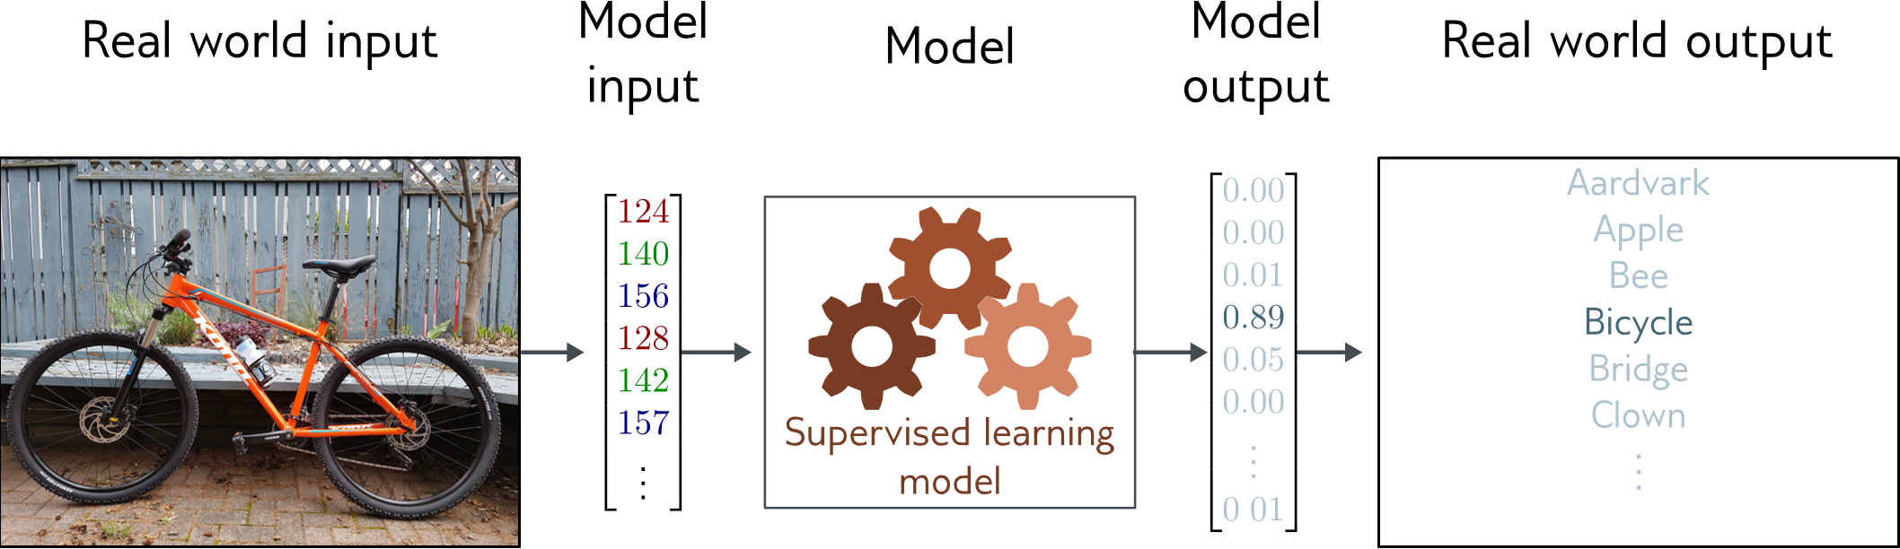
Image classification
Multiclass classification problem (discrete classes, >2 possible classes)
Convolutional network

Slide 4
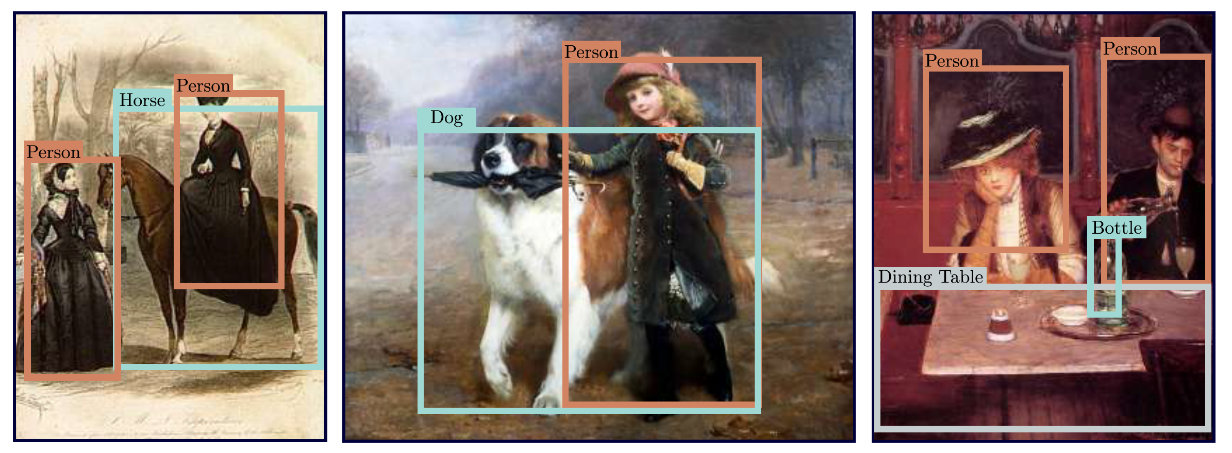
Object detection

Slide 5
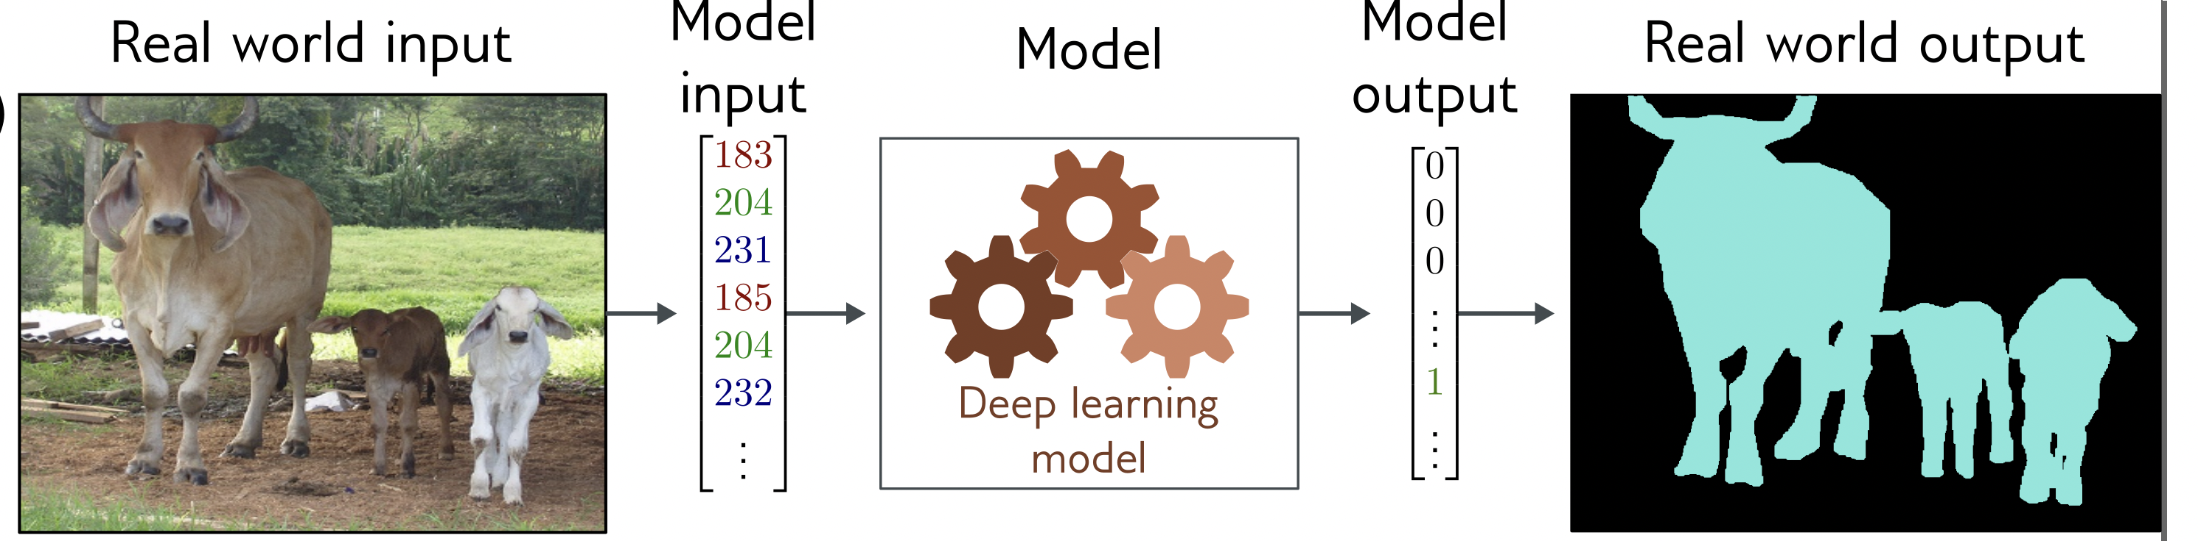
Image segmentation
Multivariate binary classification problem (many outputs, two discrete classes)
Convolutional encoder-decoder network

Slide 6
Networks for images
Problems with fully-connected networks
Size
224x224 RGB image = 150,528 dimensions
Hidden layers generally larger than inputs
One hidden layer = 150,520x150,528 weights -- 22 billion
Nearby pixels statistically related
But could permute pixels and relearn and get same results with FC
Should be stable under transformations
Don’t want to re-learn appearance at different parts of image

Slide 7
Convolutional networks
Parameters only look at local image patches
Share parameters across image

Slide 8
Convolutional networks
Networks for images
Invariance and equivariance
1D convolution
Convolutional layers
Channels
Receptive fields
Convolutional network for MNIST 1D

Slide 9
Invariance
A function f[x] is invariant to a transformation t[] if:
i.e., the function output is the same even after the transformation is applied.
Notes:
Transformation: translated, rotated, flipped, and wrapped.

Slide 10
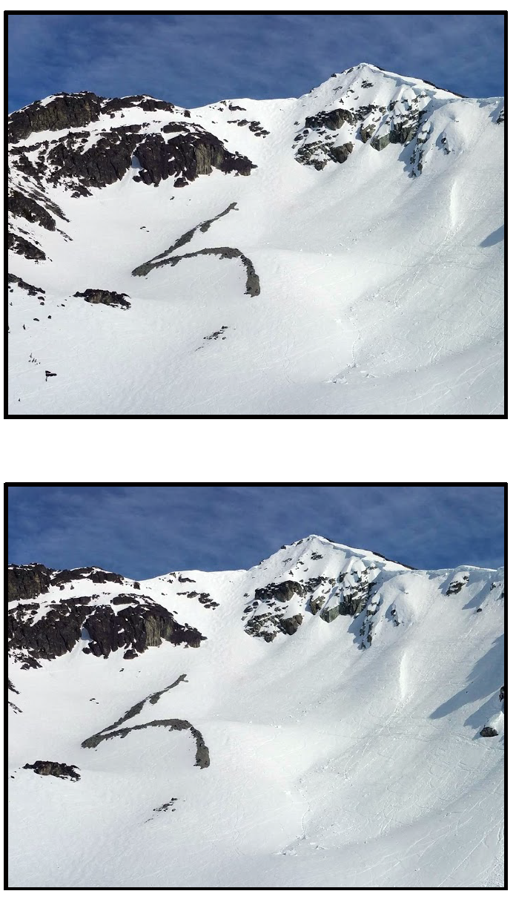
Invariance example
e.g., Image classification
Image has been translated, but we want our classifier to give the same result

Slide 11
Equivariance
A function f[x] is equivariant to a transformation t[] if:
i.e., the output is transformed in the same way as the input

Slide 12
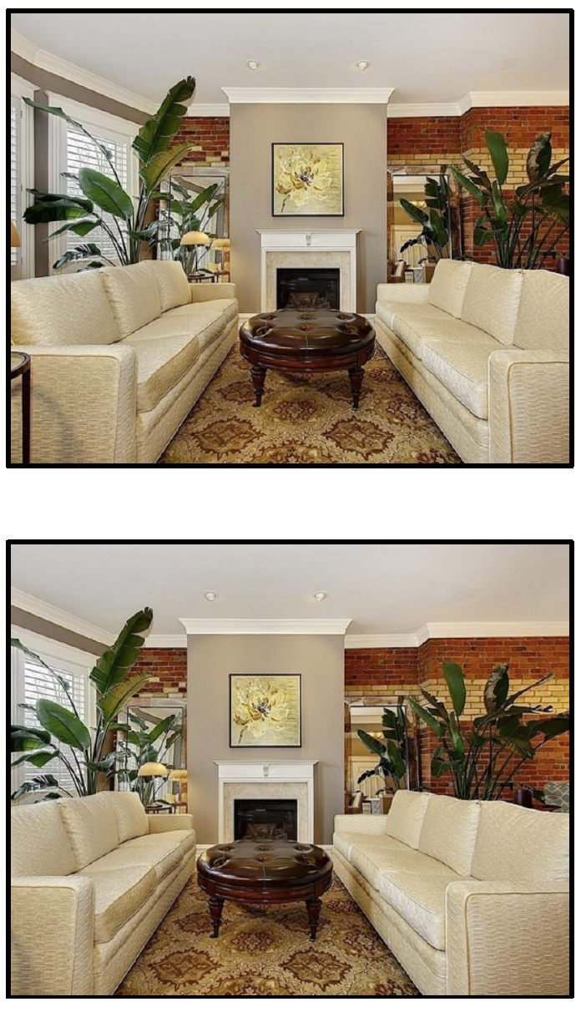
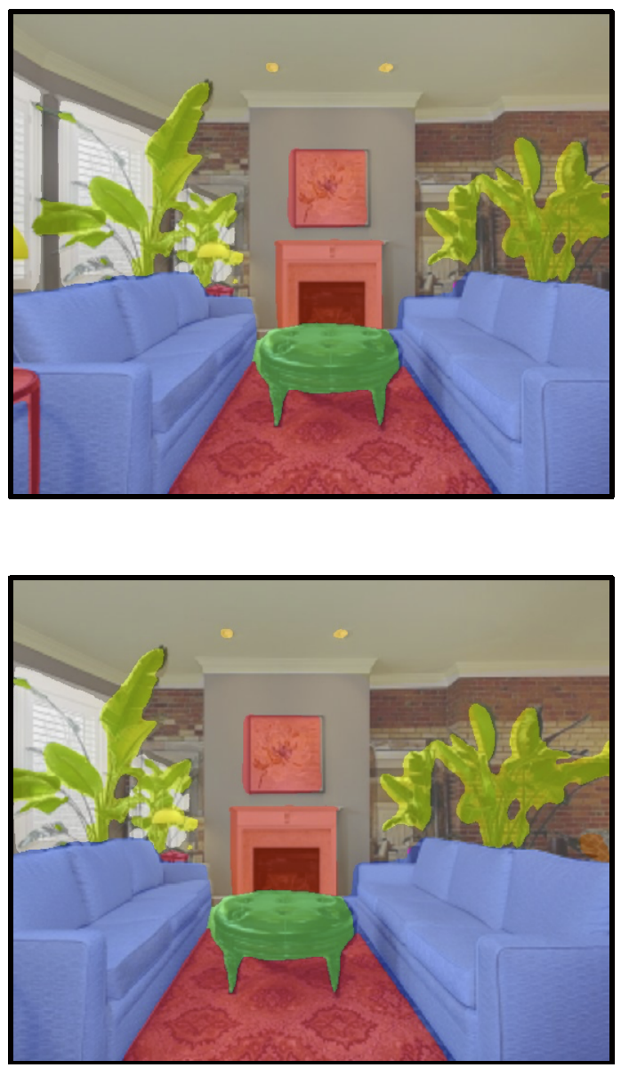
Equivariance example
e.g., Image segmentation
Image has been translated and we want segmentation to translate with it

Slide 13
Convolutional networks
Networks for images
Invariance and equivariance
1D convolution
Convolutional layers
Channels
Receptive fields
Convolutional network for MNIST 1D

Slide 14
Convolution* in 1D
Input vector x:
Output is weighted sum of neighbors:
Convolutional kernel or filter:
Kernel size = 3

Slide 15
Convolution with kernel size 3

Slide 16
Convolution with kernel size 3

Slide 17
Convolution with kernel size 3

Slide 18
Zero padding
Treat positions that are beyond end of the input as zero.

Slide 19
“Valid” convolutions
Only process positions where kernel falls in image (smaller output).

Slide 20
Stride, kernel size, and dilation
Stride = shift by k positions for each output
Decreases size of output relative to input
Kernel size = weight a different number of inputs for each output
Combine information from a larger area
But kernel size 5 uses 5 parameters
Dilated or atrous convolutions = intersperse kernel values with zeros
Combine information from a larger area
Fewer parameters

Slide 21
1

Slide 22
1
1

Slide 23
1
1
1

Slide 24
1
1
1
2

Slide 25
Convolutional networks
Networks for images
Invariance and equivariance
1D convolution
Convolutional layers
Channels
Receptive fields
Convolutional network for MNIST 1D

Slide 26
Convolutional layer

Slide 27
Special case of fully-connected network
Convolutional network:
Fully connected network:

Slide 28
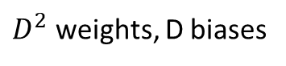
Special case of fully-connected network
Convolutional network:
3 weights, 1 bias
Fully connected network:
$D^{2}$ weights, D biases

Slide 29
Special case of fully-connected network
Fully connected network

Slide 30
Special case of fully-connected network
Fully connected network
Convolution, kernel 3,
stride 1, dilation 1

Slide 31
Special case of fully-connected network
Fully connected network
Convolution, size 3, stride 1,
dilation 1, zero padding
Convolution, size 3, stride 2,
dilation 1, zero padding

Slide 32
Question 1
Kernel size?
Stride?
Dilation?
Zero padding / valid?

Slide 33
Question 2
Kernel size?
Stride?
Dilation?
Zero padding / valid?

Slide 34
Question 3
Kernel size?
Stride?
Dilation?
Zero padding / valid?

Slide 35
Convolutional networks
Networks for images
Invariance and equivariance
1D convolution
Convolutional layers
Channels
Receptive fields
Convolutional network for MNIST 1D

Slide 36
Channels
The convolutional operation averages together the inputs
Plus passes through ReLU function
Has to lose information
Solution:
apply several convolutions and stack them in channels
Sometimes also called feature maps

Slide 37
Two output channels, one input channel

Slide 38
Two output channels, one input channel

Slide 39
Two input channels, one output channel

Slide 40
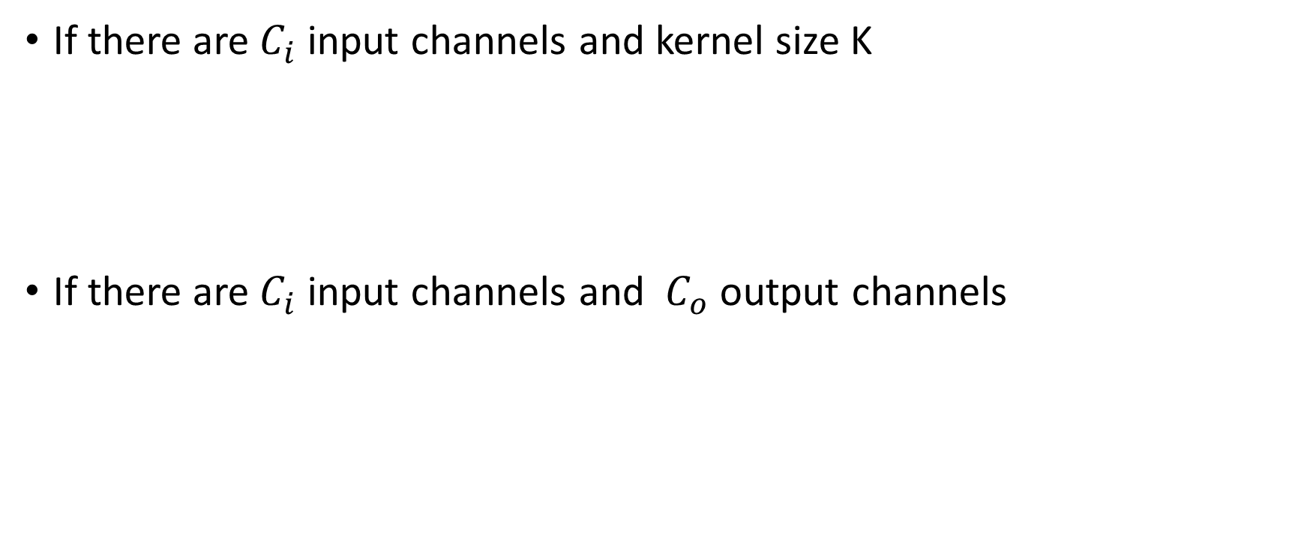
How many parameters?
If there are${ C}_{i}$ input channels and kernel size K
If there are${ C}_{i}$ input channels and ${ C}_{o}$ output channels

Slide 41
Convolutional networks
Networks for images
Invariance and equivariance
1D convolution
Convolutional layers
Channels
Receptive fields
Convolutional network for MNIST 1D

Slide 42
Receptive fields

Slide 43
Receptive fields

Slide 44
Receptive fields

Slide 45
Receptive fields

Slide 46
Convolutional networks
Networks for images
Invariance and equivariance
1D convolution
Convolutional layers
Channels
Receptive fields
Convolutional network for MNIST 1D

Slide 47
MNIST 1D Dataset

Slide 48
MNIST-1D results for fully-connected network

Slide 49
Convolutional network
Four hidden layers
Three convolutional layers
One fully-connected layer
Softmax at end
Total parameters = 2050
Trained for 100,000 steps with SGD, LR = 0.01, batch size 100

Slide 50
MNIST-1D convolutional network

Slide 51
Fully connected network
Exactly same number of layers and hidden units
All fully-connected layers
Total parameters = 150,185

Slide 52
Performance

Slide 53
MNIST 1D Dataset

Slide 54
Why?
Better inductive bias
Forced the network to process each location similarly
Shares information across locations
Search through a smaller family of input/ouput mappings, all of which are plausible

Slide 55
Convolution #2
2D Convolution
Downsampling and upsampling, 1x1 convolution
Image classification
Object detection
Semantic segmentation
Residual networks
U-Nets and hourglass networks

Slide 56
2D Convolution
Convolution in 2D
Weighted sum over a K x K region
K x K weights
Build into a convolutional layer by adding bias and passing through activation function

Slide 57
2D Convolution

Slide 58
2D Convolution

Slide 59
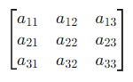
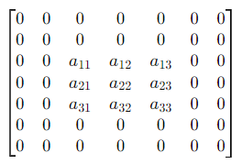
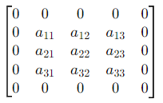
Padding
Same Padding:
Preserve the input dimensions after convolution.
Original Image
Valid Padding:
No padding
Padded with 1 0’s
Padded with 2 0’s

Slide 60
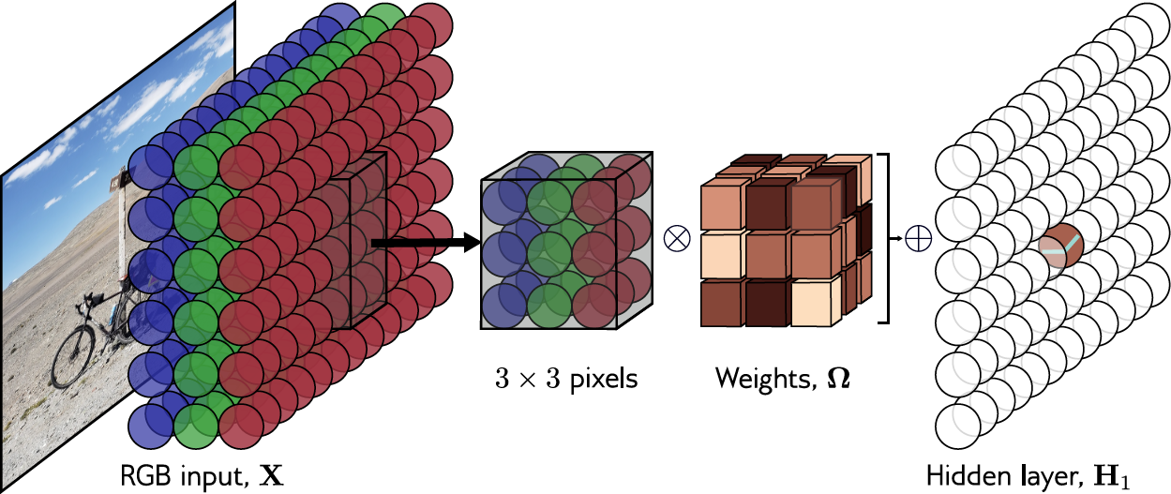
Channels in 2D convolution
Kernel size, stride, dilation all work as you would expect

Slide 61
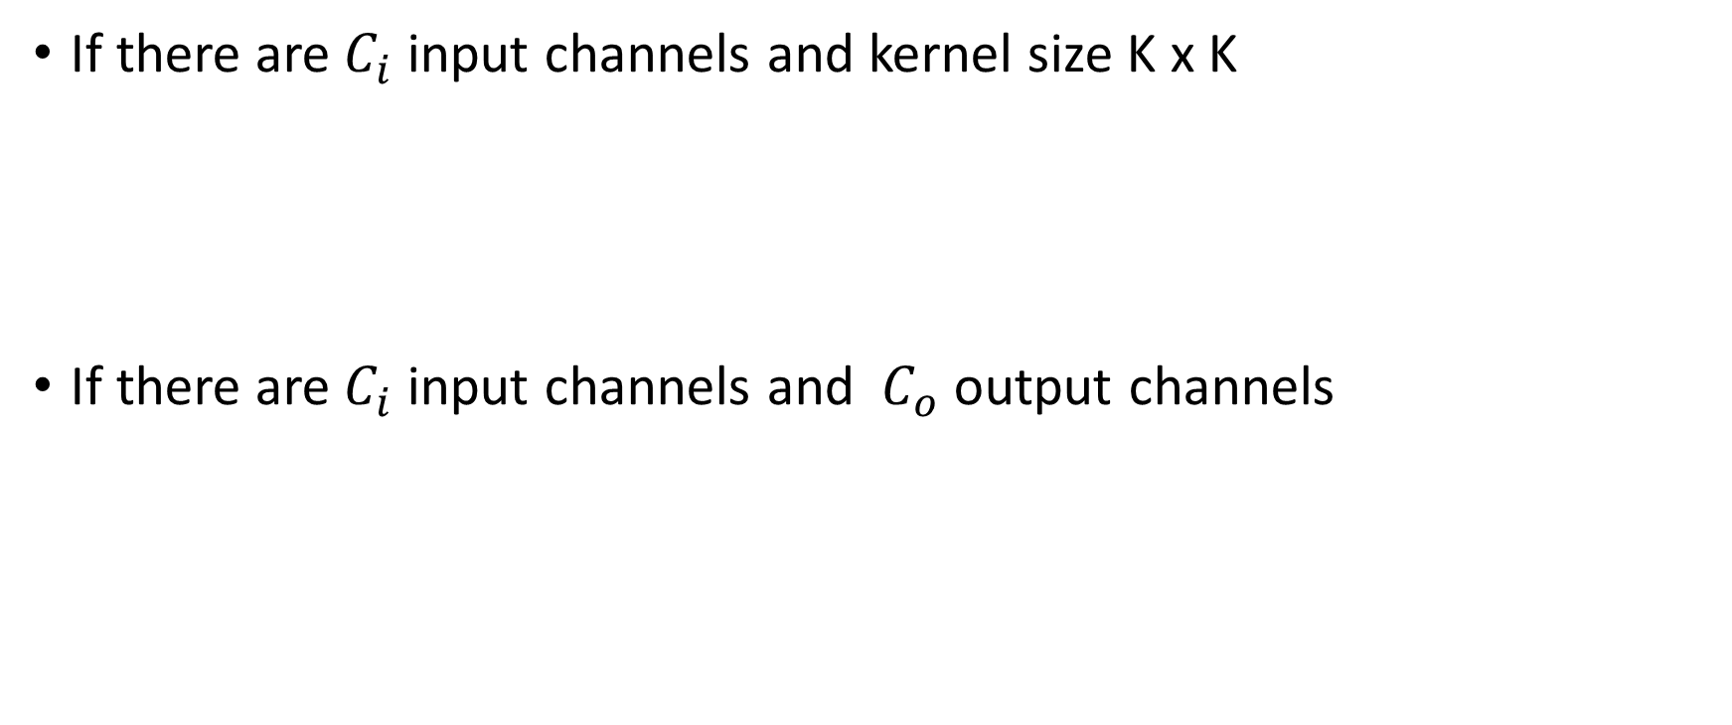
How many parameters?
If there are${ C}_{i}$ input channels and kernel size K x K
If there are${ C}_{i}$ input channels and ${ C}_{o}$ output channels

Slide 62
MNIST-1D convolutional network

Slide 63
Convolution #2
2D Convolution
Downsampling and upsampling, 1x1 convolution
Image classification
Object detection
Semantic segmentation
Residual networks
U-Nets and hourglass networks

Slide 64
Downsampling
Sample every other position (equivalent to stride two)

Slide 65
Downsampling
Sample every other position (equivalent to stride two)
Max pooling
(partial invariance to translation)

Slide 66
Downsampling
Sample every other position (equivalent to stride two)
Max pooling
(partial invariance to translation)
Mean pooling

Slide 67
Upsampling
Duplicate

Slide 68
Upsampling
Duplicate
Max-upsampling

Slide 69
Upsampling
Duplicate
Max-upsampling
Bilinear interpolation

Slide 70
Transposed convolutions
Kernel size 3, Stride 2 convolution

Slide 71
Transposed convolutions
Kernel size 3, Stride 2 convolution
Transposed convolution

Slide 72
1x1 convolution
Mixes channels
Can change number of channels
Equivalent to running same fully connected network at each position

Slide 73
Convolution #2
2D Convolution
Downsampling and upsampling, 1x1 convolution
Image classification
Object detection
Semantic segmentation
Residual networks
U-Nets and hourglass networks

Slide 74
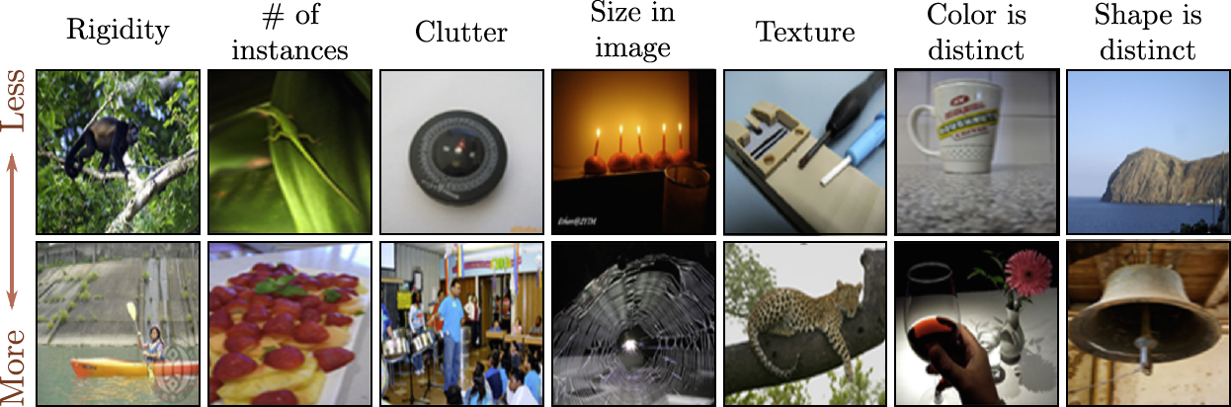
ImageNet database
224 x 224 images
1,281,167 training images, 50,000 validation images, and 100,000 test images
1000 classes

Slide 75
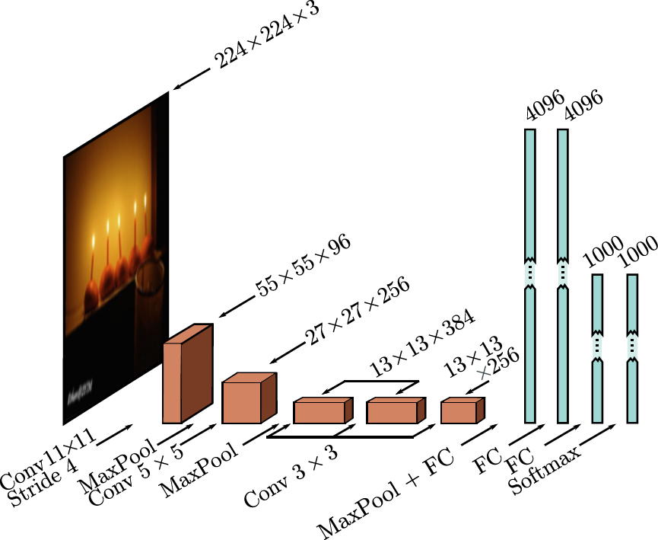
AlexNet (2012)
Almost all the 60 million parameters
parameters are in fully connected layers

Slide 76
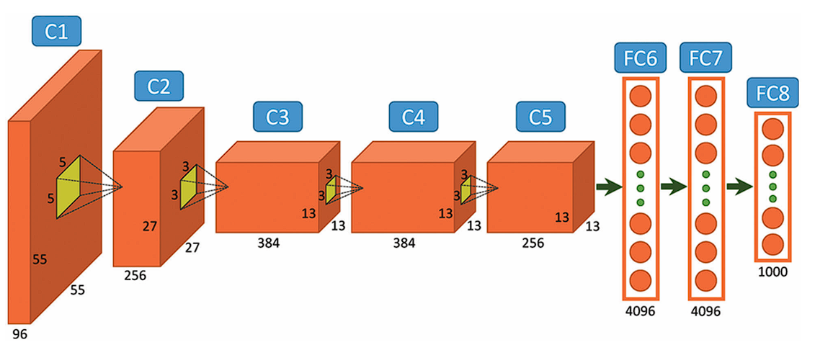

Slide 77
AlexNet structure
5 Convolutional layers and 3 fully connected layers
1st layer downsamples input using 11x11 kernel, stride of four 4 and creates 96 channels
2nd layer downsamples using a max pooling layer before applying a 5×5 kernel to create 256 channels.
There are three more convolutional layers with kernel size 3×3 eventually resulting in a 13×13 representation with 256 channels.
The final max pooling layer yields 6x6 representation with 256 channels
Next 3 fully connected layers contain 4096, 4096 and 1000 neurons respectively

Slide 78
Let’s do some calculations
Calculating height, width of convolutional layer
output_size = ceil((input_size - kernel_size + 2 * padding) / stride) + 1
Example:
input_size=224x224
kernel_size=11x11
stride=4
No Padding in this one
output_Size=(224- 11 +2*0)/4 +1
= 213/4 +1
= 53.25 +1
= 54.25
= 55
This would hence create a convolution of size 55x55
Calculation for Max Pooling layer is also same but without the padding term

Slide 79
2nd Layer calculation Example
Calculating height, width of convolutional layer
input_size=27x27
kernel_size=5x5
stride=2
padding=2
output_Size=(27 - 5 +2*2)/1 +1
= 26/1 +1
= 26 +1
= 27

Slide 80
Let’s look at the number of parameters
1st layer has each kernel of size 11x11x3 and there are 96 kernels.
Each kernel would also have bias
Hence, no. of parameters = (11x11x3+1)x96=34944

Slide 81
Size | Operation | Kernel Size | No. of Kernels/ Depth | Stride | Padding | Number of Parameters | output_size
224 * 224 * 3 | Conv1 + Relu | 11 * 11 | 96 | 4 |  | (11*11*3+1)*96 =34944
55 * 55 * 96 | Max Pooling | 3 * 3 |  | 2 |  |  | (55-3+2*0)/2 +1 =27
27 * 27 * 96 | Conv2 + Relu | 5 * 5 | 256 | 1 | 2 | (5*5*96+1)*256 =614656 | (27-5+2*2)/2 +1 =27
27 * 27 * 256 | Max Pooling | 3 * 3 |  | 2 |  |  | (27-3+2*0)/2 +1 =13
13 * 13 * 256 | Conv3 + Relu | 3 * 3 | 384 | 1 | 1 | (3*3*256+1)*384 =885120 | (13-3+2*1)/1 +1 =13
13 * 13 * 384 | Conv4 + Relu | 3 * 3 | 384 | 1 | 1 | (3*3*384+1)*384 =1327488 | (13-3+2*1)/1 +1 =13
13 * 13 * 384 | Conv5 + Relu | 3 * 3 | 256 | 1 | 1 | (3*3*384+1)*256 =884992 | (13-3+2*1)/1 +1 =13
13 * 13 * 256 | Max Pooling | 3 * 3 |  | 2

Slide 82
Size | Operation | No. of Parameters
 | Dropout (rate 0.5)
256 * 6 * 6 | FC6 + Relu | (256 * 6 * 6 + 1)* 4096=37752832
 | Dropout (rate 0.5)
4096 | FC7 + Relu | (4096+1) * 4096=16781312
4096 | FC8 + Relu | (4096 +1) * 1000=4097000
 | 1000 classes
Overall | Conv VS FC | Conv:3.7million (6%) , FC: 58.6 million (94% )

Slide 83
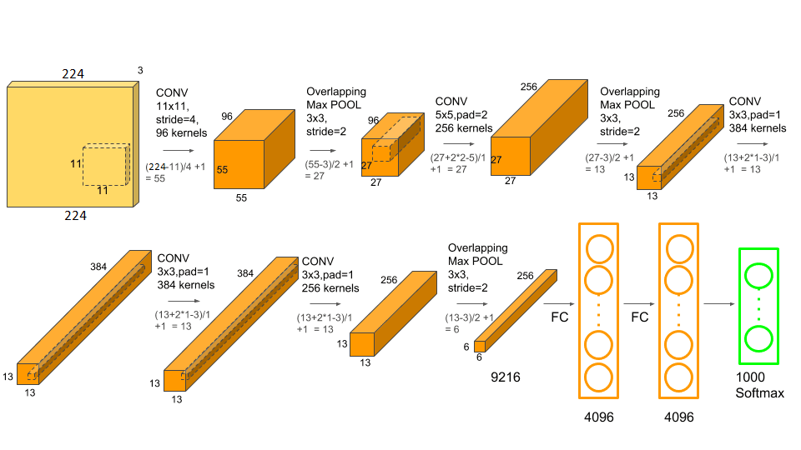

Slide 84
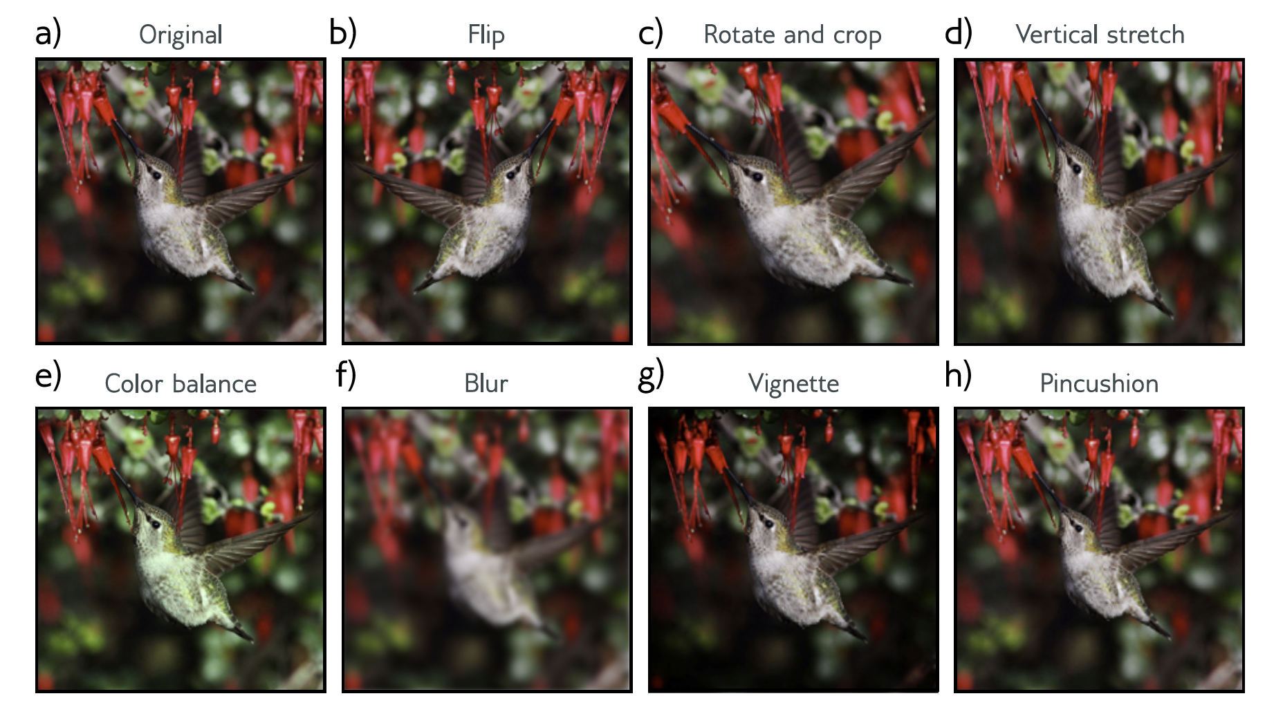
Data augmentation
Data augmentation a factor of 2048 using (i) spatial transformations and (ii) modifications of the input intensities.

Slide 85
Dropout
Dropout was applied in the fully connected layers

Slide 86
Details
At test time average results from five different cropped and mirrored versions of the image
SGD with a momentum coeﬀicient of 0.9 and batch size of 128.
L2 (weight decay) regularizer used.
This system achieved a 16.4% top-5 error rate and a 38.1% top-1 error rate.

Slide 87
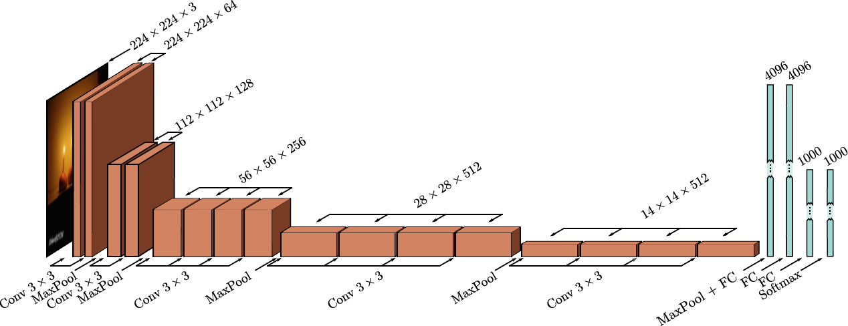
VGG (2015)

Slide 88
Activity 8
Make a similar table as in slides no. 81 and 82.
Calculate the output size and number of parameters for VGG

Slide 89
Details
19 hidden layers
144 million parameters
6.8% top-5 error rate, 23.7% top-1 error rate

Slide 90
ImageNet History

Slide 91
Convolution #2
2D Convolution
Downsampling and upsampling, 1x1 convolution
Image classification
Object detection
Semantic segmentation
Residual networks
U-Nets and hourglass networks

Slide 92
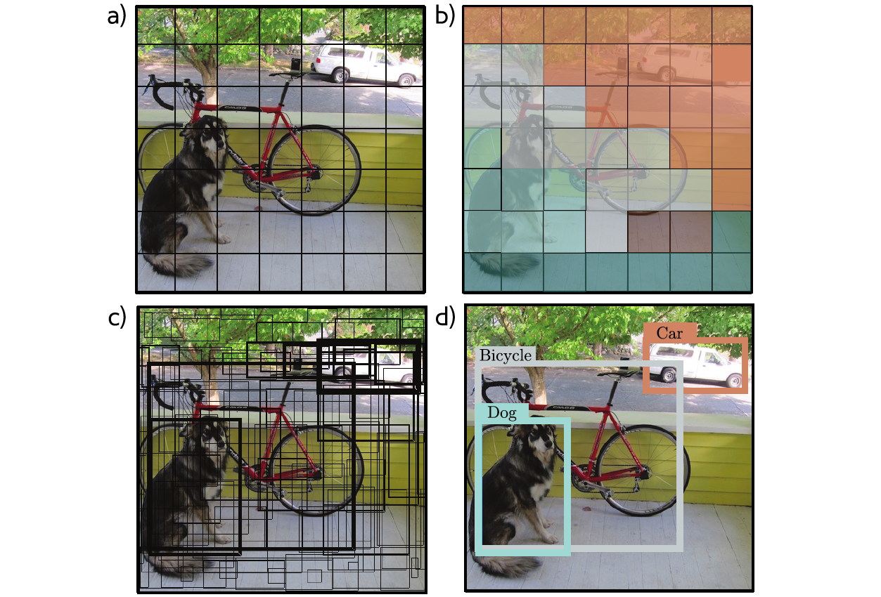
You Only Look Once (YOLO)
Network similar to VGG (448x448 input)
7×7 grid of locations
Predict class at each location
Predict 2 bounding boxes at each location
Five parameters –x,y, height, width, and confidence
Momentum, weight decay, dropout, and data augmentation
Heuristic at the end to threshold and decide final boxes

Slide 93
Object detection (YOLO)

Slide 94
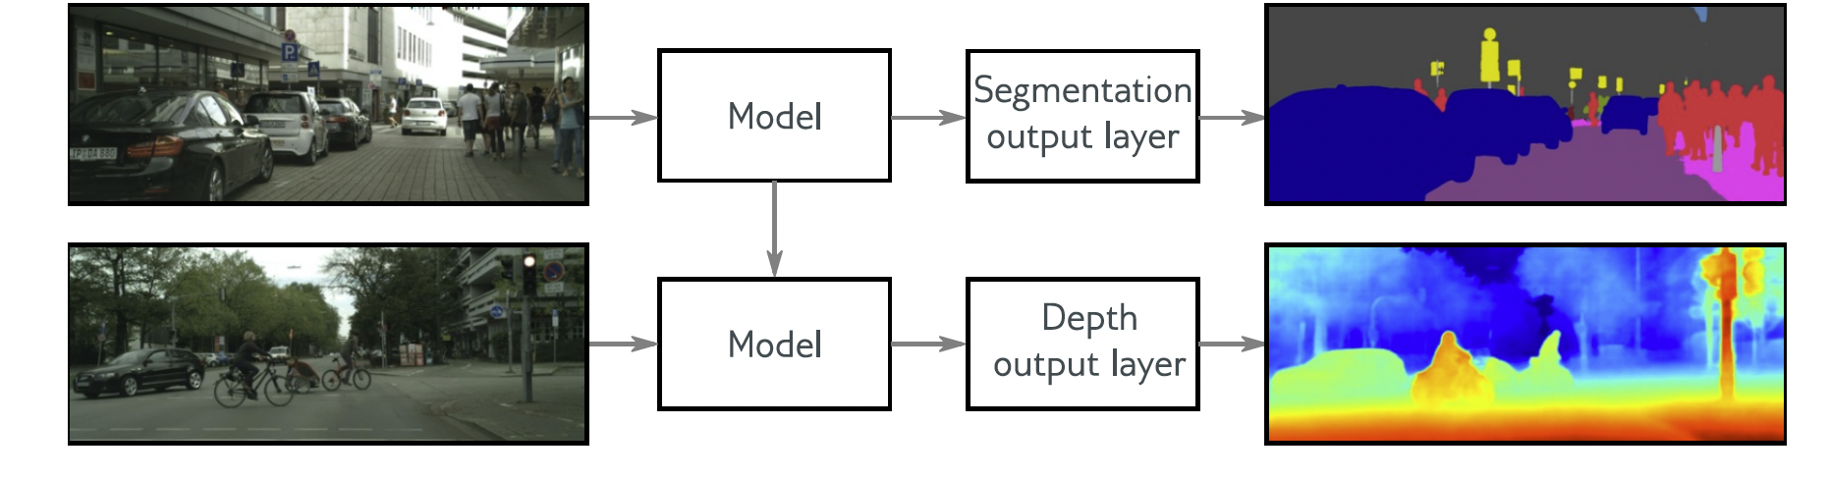
Transfer learning
Transfer learning from ImageNet classification

Slide 95
Results

Slide 96
Convolution #2
2D Convolution
Downsampling and upsampling, 1x1 convolution
Image classification
Object detection
Semantic segmentation
Residual networks
U-Nets and hourglass networks

Slide 97
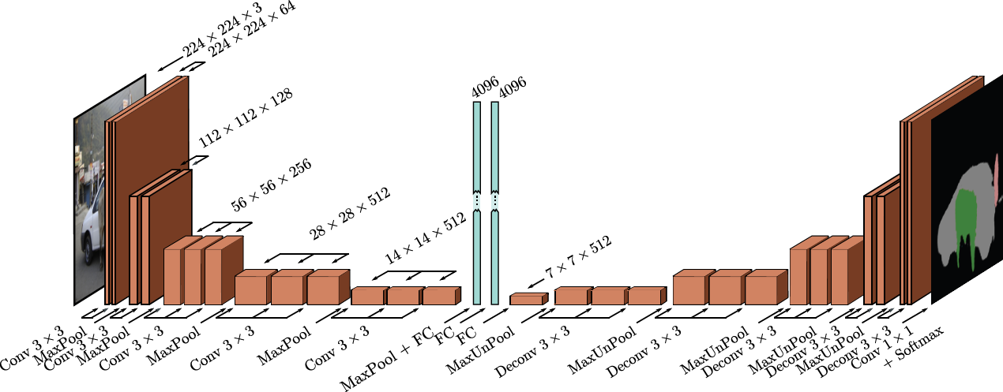
Semantic Segmentation (2015)
Encoder Decoder

Slide 98
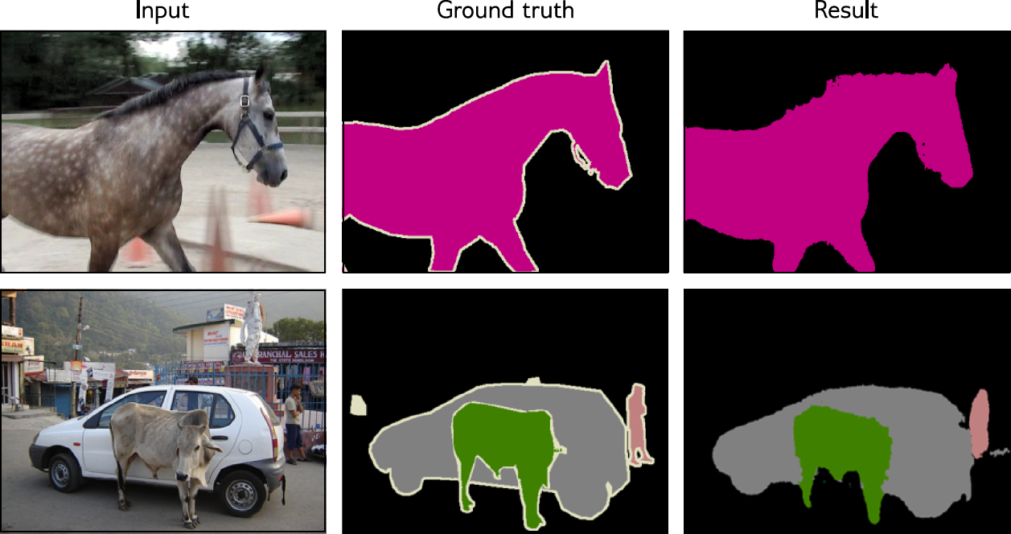
Semantic segmentation results

Slide 99
Convolution #2
2D Convolution
Downsampling and upsampling, 1x1 convolution
Image classification
Object detection
Semantic segmentation
Residual networks
U-Nets and hourglass networks

Slide 100
CIFAR Image classification for deeper networks

Slide 101
Regular network:

Slide 102
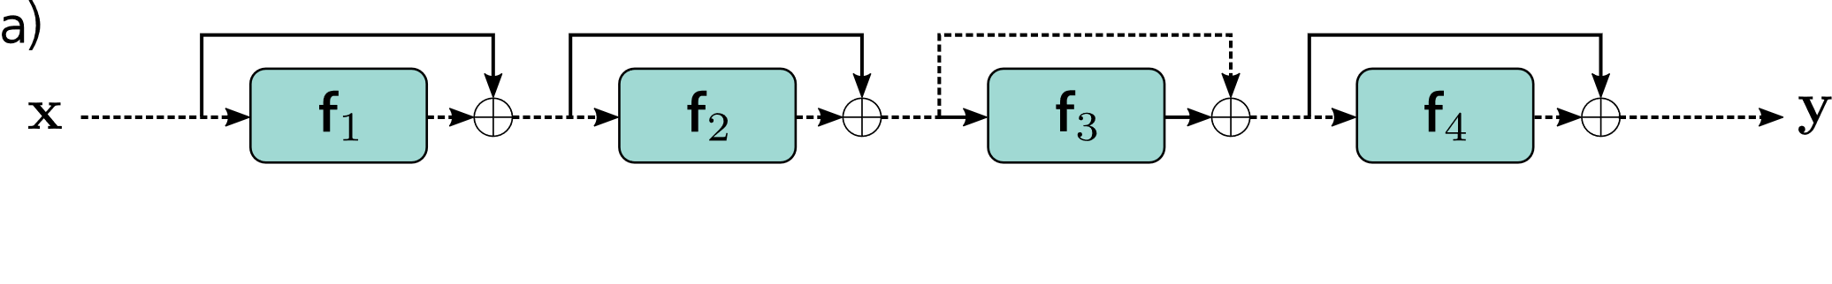
Regular network:
Residual network (2016):

Slide 103
Order of operations is important
+ Batch Norm

Slide 104
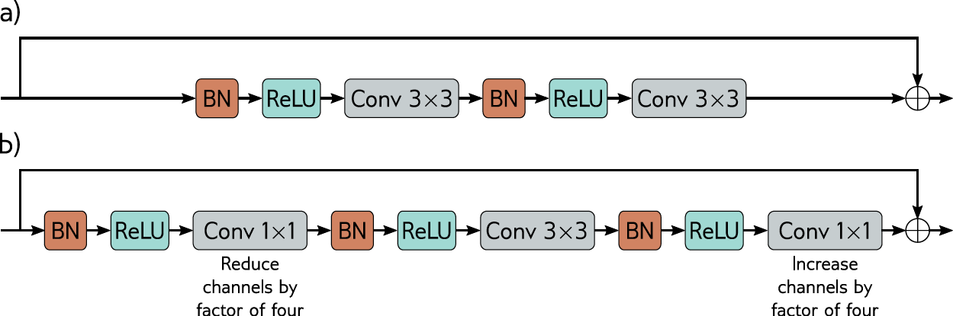
Resnet Block

Slide 105
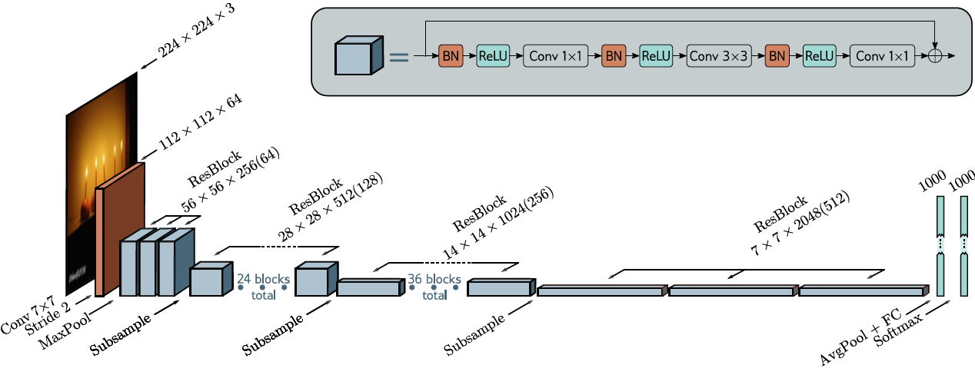
Resnet 200 (2016)

Slide 106
ImageNet History

Slide 107
Convolution #2
2D Convolution
Downsampling and upsampling, 1x1 convolution
Image classification
Object detection
Semantic segmentation
Residual networks
U-Nets and hourglass networks

Slide 108
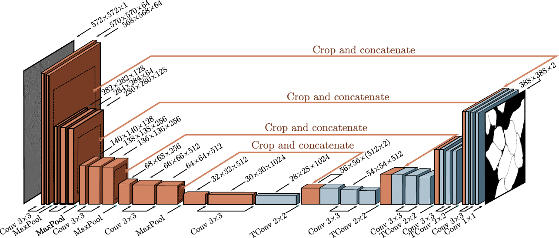
U-Net (2016)

Slide 109
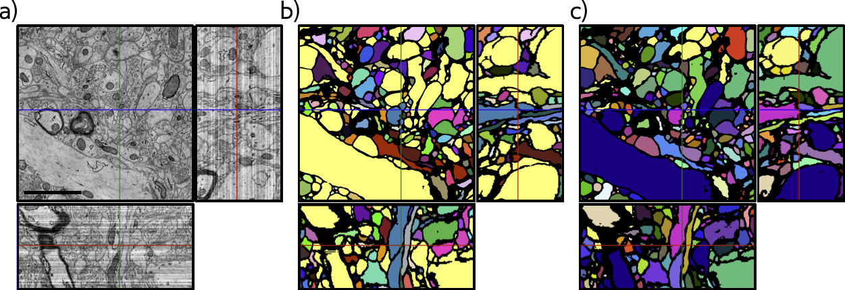
U-Net Results

Slide 110
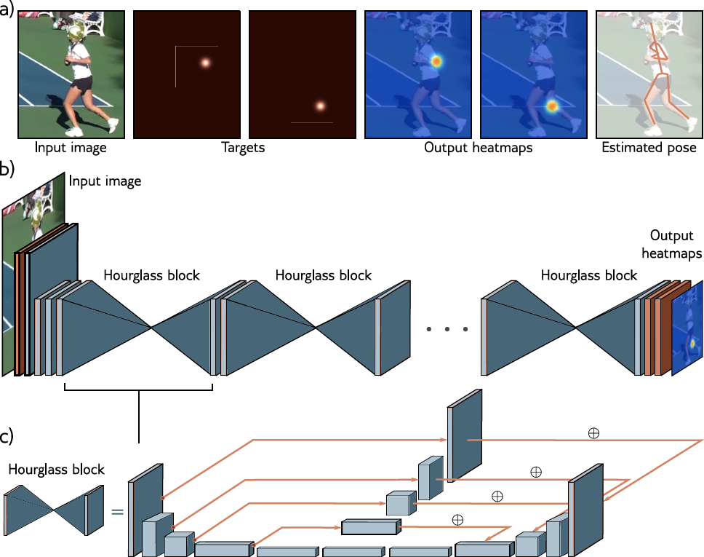
Stacked hourglass networks (2016)

